Slide 1
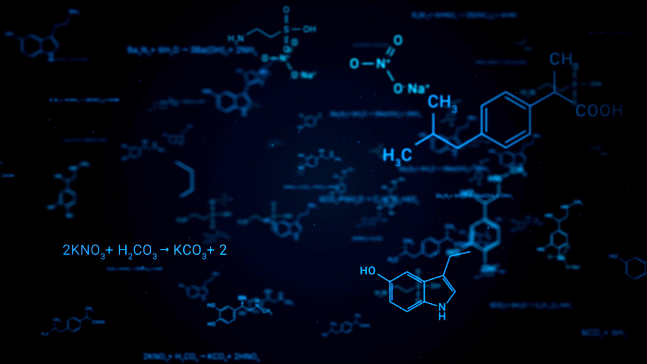
Assay of Alcohol Dehydrogenase (ADH)
Laxman Manjhi 2019BB10034
Ratnesh Kumar Sharma 2019BB10047

Slide 2

BACKGROUND
Alcohol dehydrogenase (ADH) is a family of enzymes that oxidize primary or secondary alcohols to aldehydes or ketones.
ADH uses NAD+ or NADP+ as coenzyme which is reduced during reaction.
R-CH2-OH can be converted to R-CHO + NADH + H+ in a reaction catalyzed by ADH.
NADH has strong UV absorbance at 340 nm, while oxidized NAD+ has little to no absorbance at this wavelength.
Absorbance of solution at 340 nm increases as NADH is formed during reaction.
Reaction can be monitored by starting with a mixture of ethanol, NAD+, and enzyme in buffer and measuring absorbance until equilibrium is established.

Slide 3

Method
Prepare
Prepare two reaction systems: Test and Blank
Test
Test: 0.6 ml Phosphate buffer + 0.2 ml NAD+ + 0.1 ml Enzyme (Final Reaction Volume = 0.9 ml)
Blank
Blank: 0.75 ml Phosphate buffer + 0.2 ml NAD+ + 0.1 ml Enzyme (Final Reaction Volume = 1.050 ml)
Calibrate
Calibrate the Blank in a UV spectrophotometer at 340nm using 1 ml of the solution
Start
Start the reaction by adding 0.15 ml of alcohol to the Test and measuring the absorbance at 340 nm
Take
Take readings at every 30 seconds for 2-3 minutes and calculate the unit activity of the enzyme using the change in absorbance per unit time (dA/dt).

Slide 4
Observation
Time (sec) | Abs(8) | Abs(20)
0 | 0.45 | 0.386
30 | 0.995 | 0.638
60 | 1.328 | 0.829
90 | 1.624 | 1.005
120 | 1.882 | 1.175
150 | 2.086 | 1.332
180 | 2.265 | 1.47

Slide 5
Time vs concentrations of enzymes
Time (min) | Conc(E8) in M |  | Time(min) | Conc(E20) in M
0 | 7.23473E-05 |  | 0 | 6.20579E-05
0.5 | 0.000159968 |  | 0.5 | 0.000102572
1 | 0.000213505 |  | 1 | 0.00013328
1.5 | 0.000261093 |  | 1.5 | 0.000161576
2 | 0.000302572 |  | 2 | 0.000188907
2.5 | 0.00033537 |  | 2.5 | 0.000214148
3 | 0.000364148 |  | 3 | 0.000236334

Slide 8

Calculation and result
Activity of enzyme(8) = 0.0001 * 10^6 = 100 μmol min⁻¹
Activity of enzyme(20) = 0.00009 * 10^6 = 90 μmol min⁻¹

Slide 9
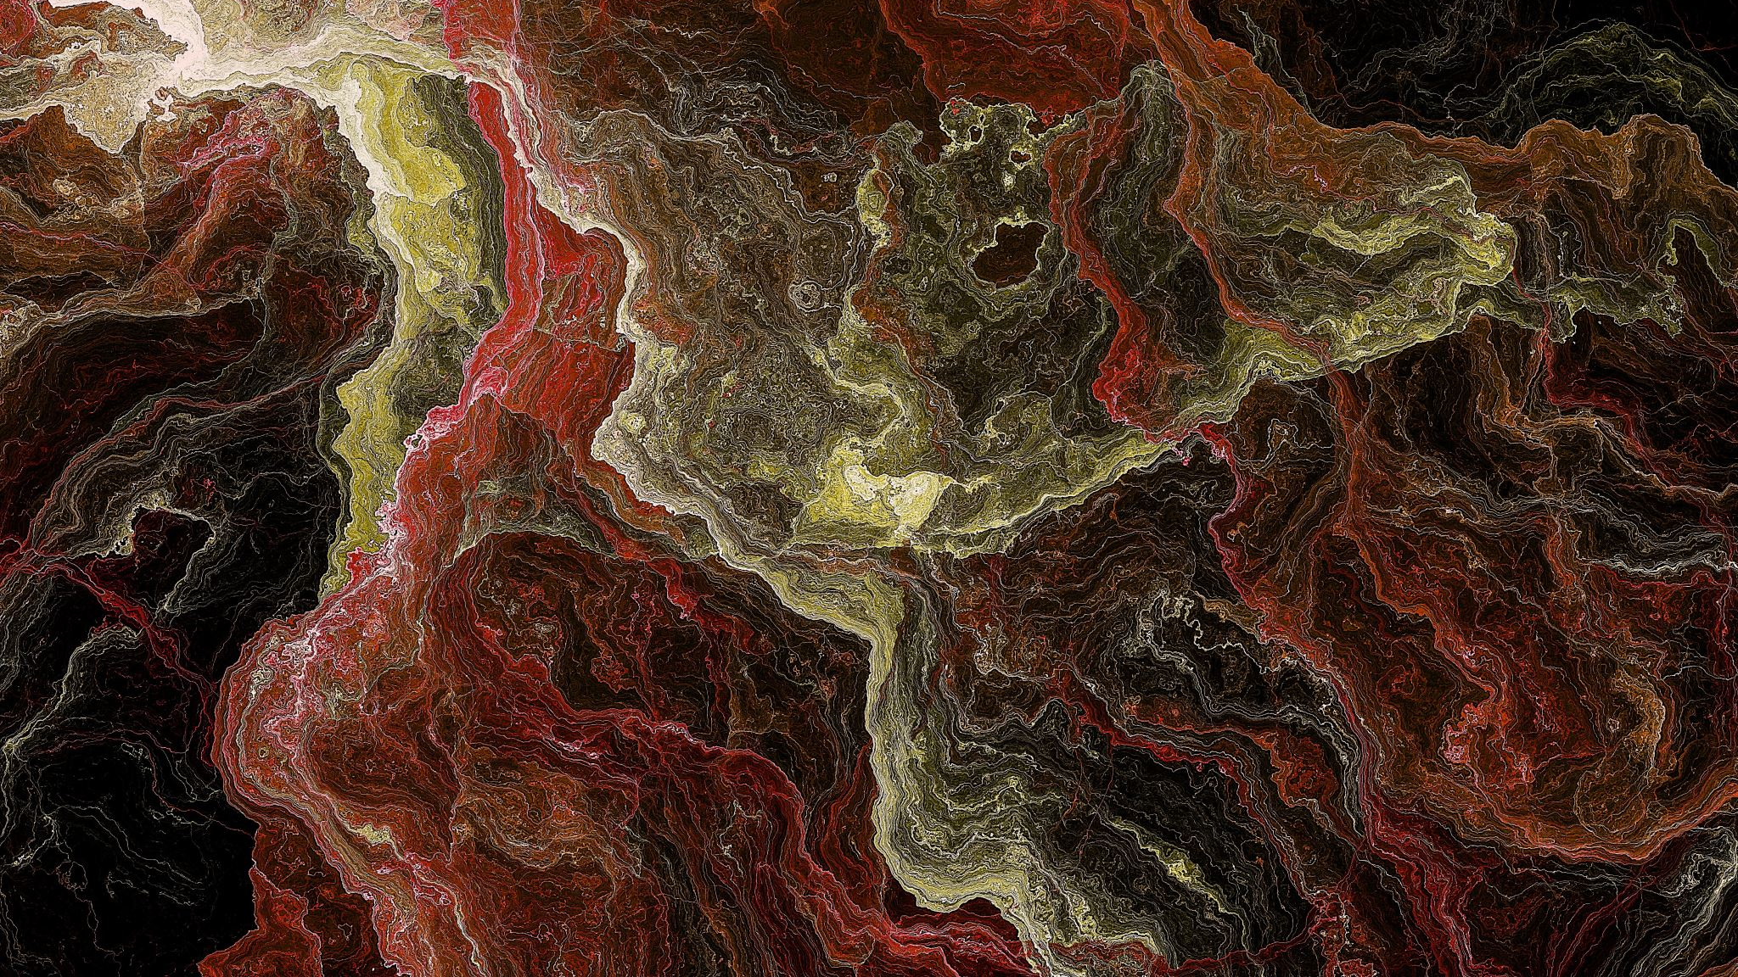
Thank you

